Slide 1



Act I – From Chaos to Control: The Stars Financial Command Center
Projected EHO4AII Star Rating
Projected
(Without Intervention)
3.5
From static reports to predictive foresight – see your stars future before CMS does!
Projected
(With Intervention)
4
HEI Scorecard
HEI Score Below Average
Equity isn't just ethical – it's profitable!
Reward Status Not On Track
Revenue Impact
Current Post Intervention
Revenue at Risk -$50M +$45M
QBP Eligibility
Every decimal in stars is
millions in revenue – and reputation!
What-If Scenario Planner – Slide your way from assumptions to outcomes
Model the improvement in any stars measure – screenings, adherence, or vaccines
Instantly see projected stars lift and financial upside in real time
"Machine Learning transforms stars management from retrospective reporting to real time financial command"
Notes:
Assessment Center is the “brain” of adaptivity and efficiency. It enables confidence-based early stopping—no over-questioning. It leverages real-time EMR data, prior answers, and payer rules. It’s the main differentiator from legacy systems and static forms.
“Low‑Back‑Pain MRI, adaptive flow”
Order placed in EMR; CRD indicates PA is needed and launches DTR.
DTR app auto‑resolves Centene from Coverage; fetches the LBP Questionnaire package.
The app runs CQL to pre‑fill prior conservative therapies, recent pain scores, and diagnosis from the chart.
Assessment Center sees sufficient evidence for certain criteria and serves a short segment:
Q1: confirm duration of symptoms (pre‑filled default; clinician verifies)
Q2: confirm failed PT within last 6 weeks (CQL found PT notes; clinician attests)
Q3: red‑flag screen (neurologic deficit)—clinician marks “No”
Confidence threshold reached → stop (no remaining 27 questions)
(“30 → 4” is User‑provided exemplar; behavior matches confidence‑based stop.)
The completed QuestionnaireResponse is saved in EMR; the back‑office uses it in PAS $submit; payer confirms and returns Response.

Slide 2
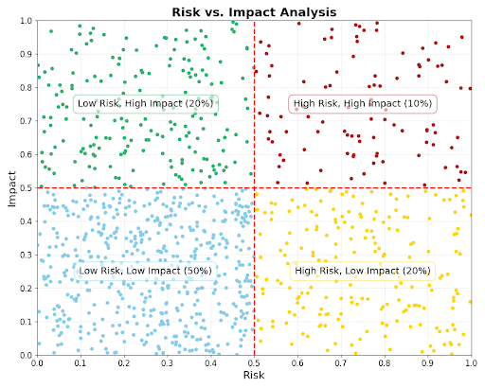
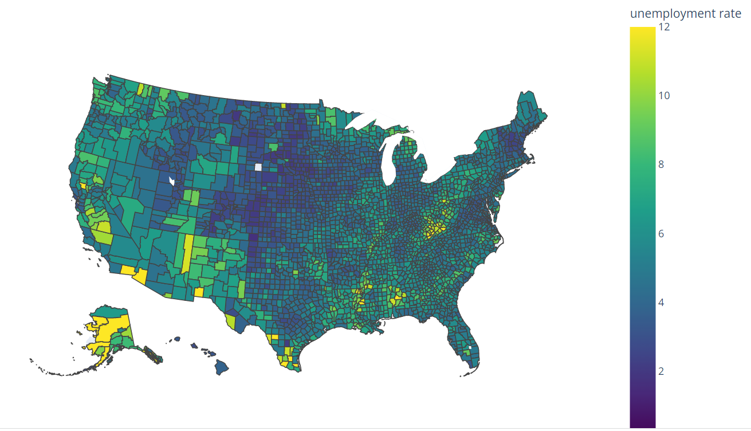
Act II – From What Happened to Why it Happened: Equity Gap Explorer
Measure Disparity Analysis
Predictive Risk Stratification
Geospatial & SDoH Overlay
Identify and prioritize measures where targeted improvement yields maximum stars impact.
AI pinpoints the small cohort of members driving majority of the gap combined with the likelihood to respond to targeted interventions.
The challenge isn't everywhere – its concentrated and solvable.
"We found the WHY. The problem isn't systemic – it's localized, concentrated and actionable."
Notes:
Assessment Center is the “brain” of adaptivity and efficiency. It enables confidence-based early stopping—no over-questioning. It leverages real-time EMR data, prior answers, and payer rules. It’s the main differentiator from legacy systems and static forms.
“Low‑Back‑Pain MRI, adaptive flow”
Order placed in EMR; CRD indicates PA is needed and launches DTR.
DTR app auto‑resolves Centene from Coverage; fetches the LBP Questionnaire package.
The app runs CQL to pre‑fill prior conservative therapies, recent pain scores, and diagnosis from the chart.
Assessment Center sees sufficient evidence for certain criteria and serves a short segment:
Q1: confirm duration of symptoms (pre‑filled default; clinician verifies)
Q2: confirm failed PT within last 6 weeks (CQL found PT notes; clinician attests)
Q3: red‑flag screen (neurologic deficit)—clinician marks “No”
Confidence threshold reached → stop (no remaining 27 questions)
(“30 → 4” is User‑provided exemplar; behavior matches confidence‑based stop.)
The completed QuestionnaireResponse is saved in EMR; the back‑office uses it in PAS $submit; payer confirms and returns Response.

Slide 3







Act III – From Insight to Action: Smart Workbench
Hidden barriers surfaced automatically, making outreach more empathetic and effective.
From the thousand names to the 50 that
matter most today.
Care teams act faster, smarter,
and with measurable impact
Mail at-home test kit (82% predicted success)
"I have transportation issues"
"Anxious about screenings"
Offer transportation to clinic (65%)
Follow-up call in 7 days (57%)
Every member. Every outreach. Evidence based.
No guesswork – all powered by predictive intelligence
Notes:
Assessment Center is the “brain” of adaptivity and efficiency. It enables confidence-based early stopping—no over-questioning. It leverages real-time EMR data, prior answers, and payer rules. It’s the main differentiator from legacy systems and static forms.
“Low‑Back‑Pain MRI, adaptive flow”
Order placed in EMR; CRD indicates PA is needed and launches DTR.
DTR app auto‑resolves Centene from Coverage; fetches the LBP Questionnaire package.
The app runs CQL to pre‑fill prior conservative therapies, recent pain scores, and diagnosis from the chart.
Assessment Center sees sufficient evidence for certain criteria and serves a short segment:
Q1: confirm duration of symptoms (pre‑filled default; clinician verifies)
Q2: confirm failed PT within last 6 weeks (CQL found PT notes; clinician attests)
Q3: red‑flag screen (neurologic deficit)—clinician marks “No”
Confidence threshold reached → stop (no remaining 27 questions)
(“30 → 4” is User‑provided exemplar; behavior matches confidence‑based stop.)
The completed QuestionnaireResponse is saved in EMR; the back‑office uses it in PAS $submit; payer confirms and returns Response.

Slide 4
Act I - From Financial Chaos to Strategic Control
Key Features
AI components/models
Simulation Cut off
Projected Star Rating
HEI Scorecard
SDOH Overlays
Value Delivery
Start with Standard Adaptive
for rapid, compliant value
Advance to Assessment Center
for intelligent optimization and efficiency.
Notes:
Assessment Center is the “brain” of adaptivity and efficiency. It enables confidence-based early stopping—no over-questioning. It leverages real-time EMR data, prior answers, and payer rules. It’s the main differentiator from legacy systems and static forms.
“Low‑Back‑Pain MRI, adaptive flow”
Order placed in EMR; CRD indicates PA is needed and launches DTR.
DTR app auto‑resolves Centene from Coverage; fetches the LBP Questionnaire package.
The app runs CQL to pre‑fill prior conservative therapies, recent pain scores, and diagnosis from the chart.
Assessment Center sees sufficient evidence for certain criteria and serves a short segment:
Q1: confirm duration of symptoms (pre‑filled default; clinician verifies)
Q2: confirm failed PT within last 6 weeks (CQL found PT notes; clinician attests)
Q3: red‑flag screen (neurologic deficit)—clinician marks “No”
Confidence threshold reached → stop (no remaining 27 questions)
(“30 → 4” is User‑provided exemplar; behavior matches confidence‑based stop.)
The completed QuestionnaireResponse is saved in EMR; the back‑office uses it in PAS $submit; payer confirms and returns Response.

Slide 5
Act 2 - From 'What' Happened to 'Why' it Happened
Key Features
AI components/models
Geospatial Overlay
Projected Star Rating
HEI Scorecard
Impactibiloity model
Risk Models
Value Delivery
Start with Standard Adaptive
for rapid, compliant value
Advance to Assessment Center
for intelligent optimization and efficiency.
Notes:
Assessment Center is the “brain” of adaptivity and efficiency. It enables confidence-based early stopping—no over-questioning. It leverages real-time EMR data, prior answers, and payer rules. It’s the main differentiator from legacy systems and static forms.
“Low‑Back‑Pain MRI, adaptive flow”
Order placed in EMR; CRD indicates PA is needed and launches DTR.
DTR app auto‑resolves Centene from Coverage; fetches the LBP Questionnaire package.
The app runs CQL to pre‑fill prior conservative therapies, recent pain scores, and diagnosis from the chart.
Assessment Center sees sufficient evidence for certain criteria and serves a short segment:
Q1: confirm duration of symptoms (pre‑filled default; clinician verifies)
Q2: confirm failed PT within last 6 weeks (CQL found PT notes; clinician attests)
Q3: red‑flag screen (neurologic deficit)—clinician marks “No”
Confidence threshold reached → stop (no remaining 27 questions)
(“30 → 4” is User‑provided exemplar; behavior matches confidence‑based stop.)
The completed QuestionnaireResponse is saved in EMR; the back‑office uses it in PAS $submit; payer confirms and returns Response.

